Slide 1
APPLIANCE STATE PREDICTION

Slide 2
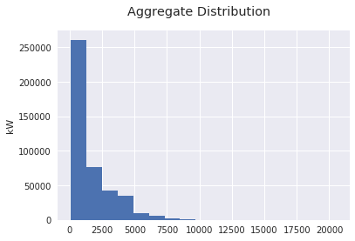
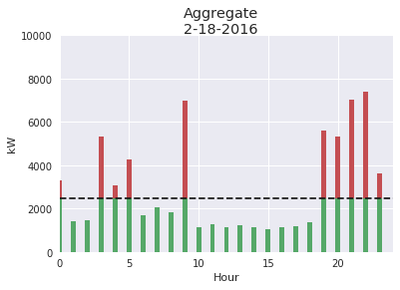

Energy Cost
Electric bill is made up by the sum of three component:
- Fixed contract (fixed by the provider)
- Total Consumption (what really you have consumed)
- Peak Demand Charges (max energy demand )
Bill item | Cost
Fixed | $ 130 Month
Hourly | $ 0.13 – 0.22 kWH
Peak | $ 18 * max kW
From 30% to 70% !!!

Slide 3
Dataset

Slide 4
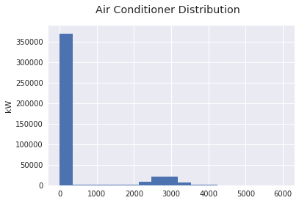
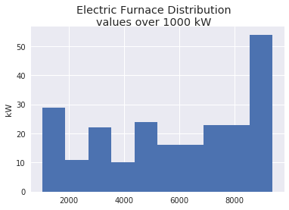
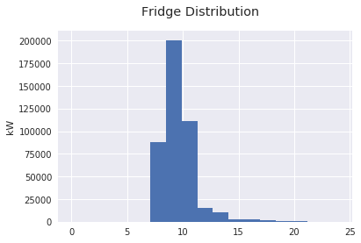
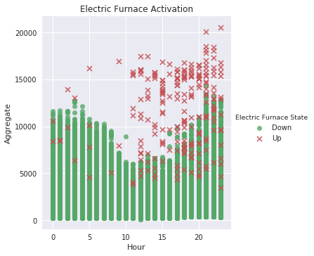
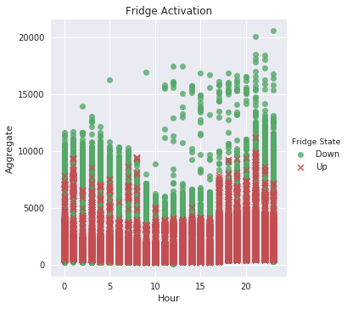
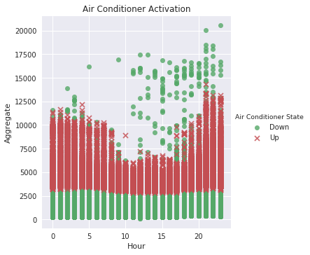
Appliance account on Aggregate

Slide 5
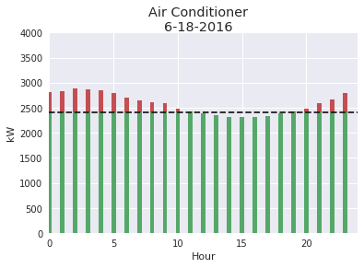
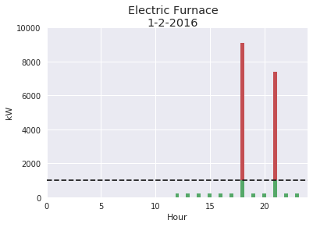
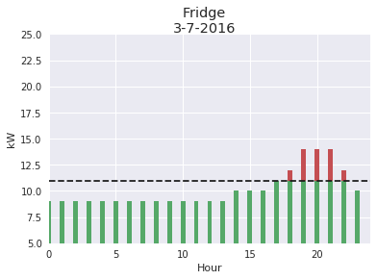
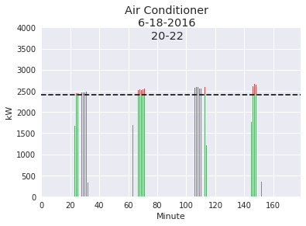
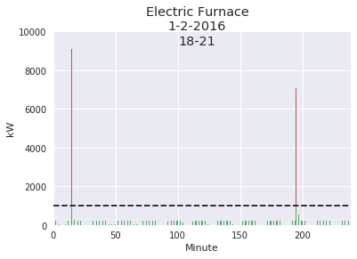
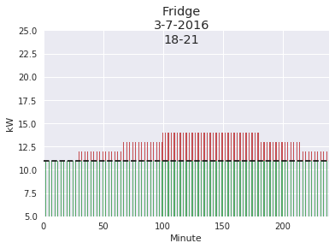
Appliance Signatures

Slide 6
Random Forest Result
Index | Value
Accuracy | .96
Precision | .79
Recall | .70
F1 - Score | .74
Feature | Importance
Aggregate | .19
Month | .30
Day | .20
Hour | .22
Minute | .07

